Slide 1
Altermagnets and spin liquids
1)
From neighboring and altermagnetic spin liquids to spin-symmetric band splitting
Hauptseminar talk by Jonas Scheunemann
Supervisors: Prof. Scheurer & MSc. Putzer
1) Sobrata, Mandel, Scheurer, 2024
Notes:
Good afternoon. I'm Jonas, and I'll close today's seminar with a question that none of the previous talks have addressed directly: what happens to an altermagnet when its spin order is destroyed by quantum fluctuations? The answer involves spin liquids, fractionalized excitations, and a new phase we'll call the altermagnetic spin liquid.

Slide 2
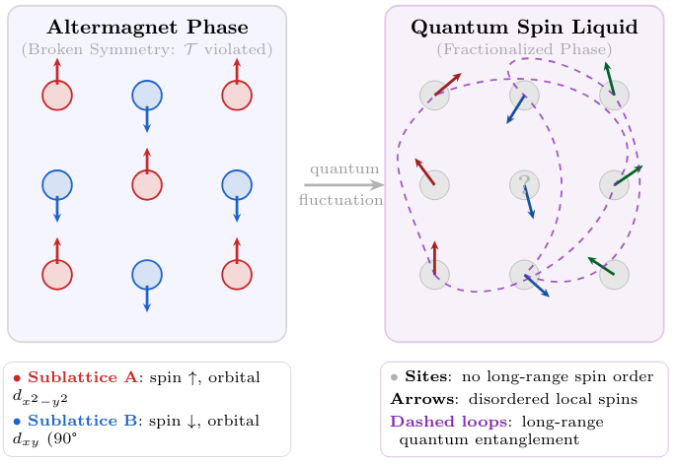
From Altermagnets to Spin Liquids
We now know a lot about ordered altermagnets (P1-P11)
ARPES
magnons
topology in band
What happens when frustration + quantum fluctuations destroy spin order?
Does altermagnetic character survive in a phase with no spin order?
Notes:
Zeitsoll am Ende: ~ 2 min — — — — — — —
Today's talks covered a lot of ground on ordered altermagnets — band splitting, ARPES measurements, magnon spectra, topology in the band structure. All of that physics assumed the spins are ordered, especially long-ranged: there is a well-defined spin texture that breaks time-reversal symmetry in a specific way. I want to go to the adjacent regime. Take that same altermagnetic system, but now make the frustrated couplings strong — strong enough that quantum fluctuations prevent the spins from ever settling into a static pattern. The spin order melts. And now the question becomes: does anything altermagnetic survive in that disordered phase?That is the question this paper answers. And the answer is yes — but the way it survives is subtle and requires new language. Let me build that language for you.
→ "To make this concrete, we need a model that is an altermagnet and, at the same time, can be strongly frustrated. Here it is."

Slide 3
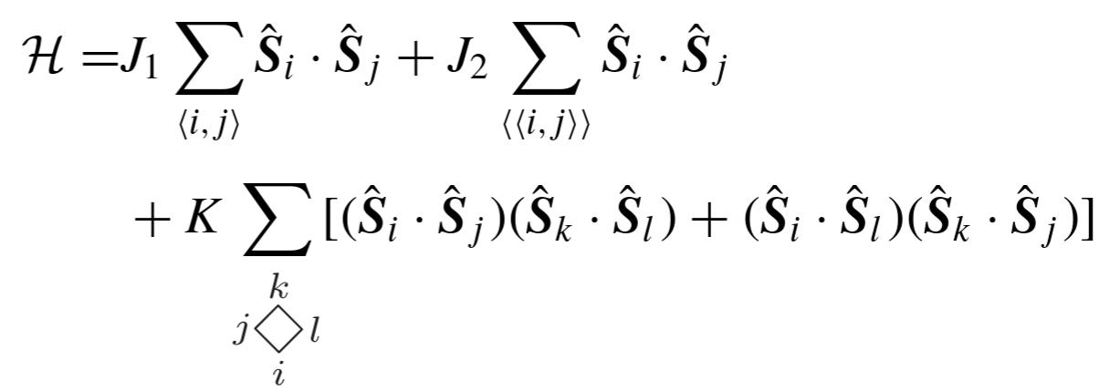
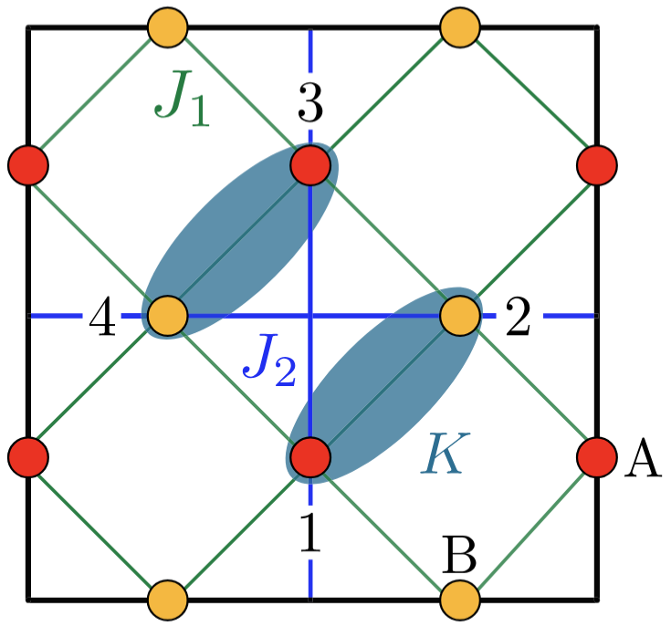
The Model
Two sublattices A/B related by C4​, not translation → altermagnetic symmetry
J2 and K introduce frustration and competing orders
Notes:
Folienende Zeitsoll kumuliert: ~ 5 min Für diese Folie: ~ 2min — — — — — — —
The model is a checkerboard Heisenberg magnet with three couplings. J₁ > 0 is antiferromagnetic connection between nearest-neighbor bonds. J₂ couples next-nearest-neighbor bonds and introduces frustration. K is a ring-exchange term that competes with collinear order and, crucially, stabilizes a noncoplanar phase. The key symmetry point, that i think we heard often enough now, so ill make it quick: the two sublattices A and B are related by a fourfold rotation C₄z, not by a lattice translation. This is exactly the altermagnetic symmetry. With only J₁, the model has an artificial translation symmetry between A and B. Adding J₂ and K breaks that translation, leaving only C₄z - and that is what makes the ground state an altermagnet rather than a conventional AFM. Now the following calculations are not limited to this model, its just one explicit example.
→ To find the connections to the quantum spin liquid, our next step is to first find different phases established by different sets of parameters J1,J2 and K

Slide 4
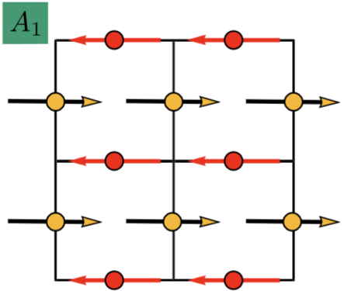
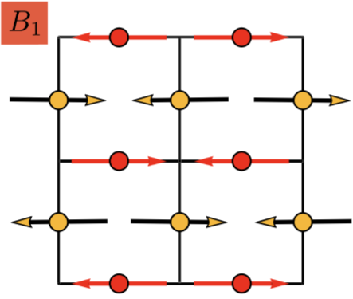
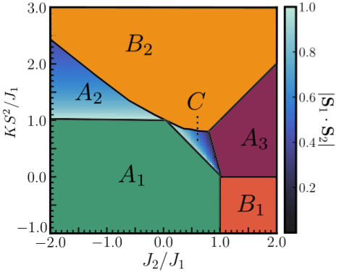
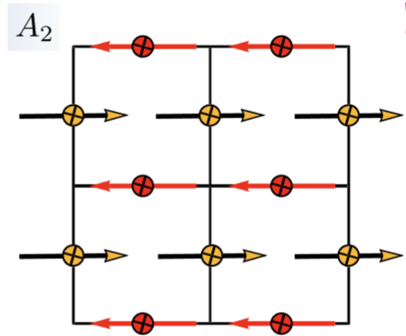
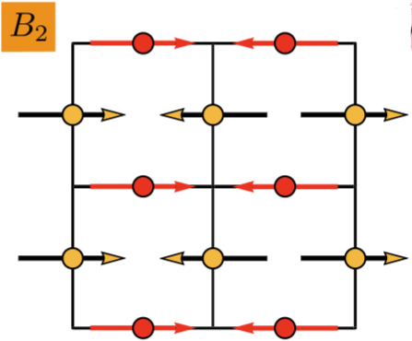
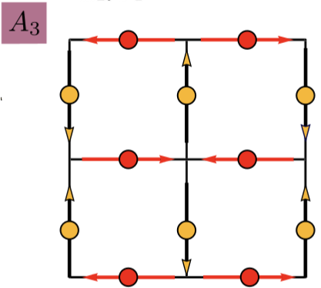
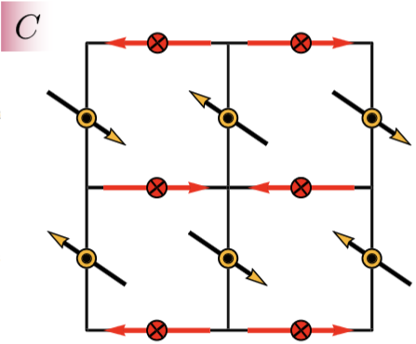
Classical Phase Diagram
Notes:
Folienende Zeitsoll kumuliert: ~ 6 min Für diese Folie: ~ 1min — — — — — — —
Here we see this phase diagram for different (J2, K) values. Now we get these by minimization of the energy for each of these points. For that we make a classical Spinansatz. Classical limit (S → ∞): spins are classical vectors, no quantum fluctuations. This Ansatz has three parameters over which we will create a grid and then find the minimum by applying the gradient descent algorithm. We repeat that for each point of the J2,K parameter space and by looking at the parameters in our spinansatz we will find these classical spin textures

Slide 5

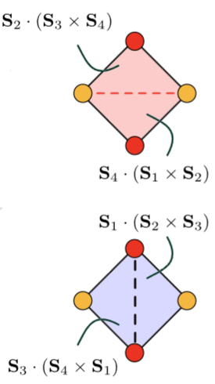

Observables
NN scalar products on a plaquette
→ C4 symmetry
Scalar spin chiralities
→T symmetry
Notes:
Folienende Zeitsoll kumuliert: ~9 min Für diese Folie: ~ 3min — — — — — — —
The key insight is this – when we later quantum-melt these phases into spin liquids, spin-rotation symmetry is restored and ⟨Si⟩=0 everywhere. A conventional magnetic order parameter vanishes. So we need observables that are spin-rotation invariant - quantities that can remain nonzero even when there is no spin polarization.
The two observables used throughout the paper are defined on a single plaquette of four spins. The first is the vector of nearest-neighbor scalar products:
SEP=(S1⋅S2, S2⋅S3, S3⋅S4, S4⋅S1)
This is invariant under global spin rotations. If all four components are equal, C4z is preserved. If they alternate — say (−1,1,−1,1)(-1,1,-1,1)(−1,1,−1,1) — then C4zC_{4z}C4z is broken. This is a nematic order parameter in the spin-rotation-invariant sector.
The second is the scalar spin chirality:
χEP=(S1⋅(S2×S3), S2⋅(S3×S4), S3⋅(S4×S1), S4⋅(S1×S2)
This requires three spins to be noncoplanar — it vanishes for all coplanar phases. It is odd under time reversal, because T flips all spin directions and a triple product of three flipped vectors acquires a minus sign.
These two observables together tell us everything we need: whether C4z is broken, whether T is broken, and — crucially — how they are broken. So lets walk through each phase and their observables together

Slide 6
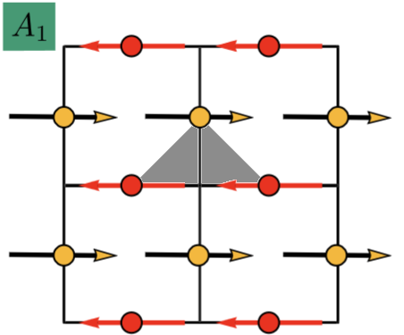
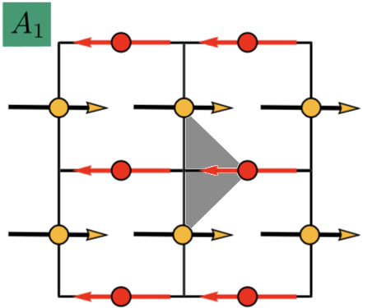
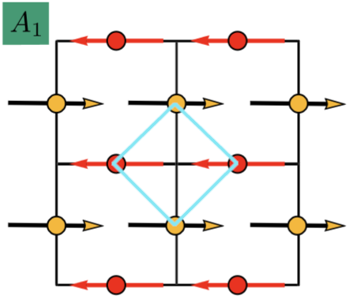

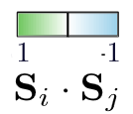
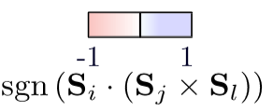


Classical Phase Diagram
Notes:
First see the color legend at the top for the values of our observables.
A1 is the collinear altermagnet — the anchor of our story. The spins on A are all pointing right, the spins on B all pointing left. The plaquette observable S_EP is uniform: −(1, 1, 1, 1). Every bond has the same antiferromagnetic scalar product. All four-fold rotational symmetry is intact.
And the chirality is zero — all spins are coplanar, so the triple product S_i · (S_j × S_k) vanishes identically. A1 is non-chiral.

Slide 7
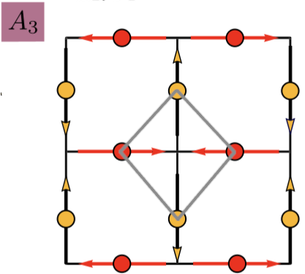

Classical Phase Diagram
Notes:
A2 is the canted altermagnet. The spins on the A sublattice develop a small out-of-plane tilt — you can see the crossed circles in the texture — generating a net magnetization. The S_EP is still uniform, −(s_0, s_0, s_0, s_0), but s_0 < 1 now because the spins are no longer perfectly antiparallel. Chirality still zero — still coplanar.
B1 is the first nematic phase. Look at the texture: horizontal bonds have antiparallel spins, but vertical bonds are nearly parallel. That anisotropy appears immediately in S_EP = (−1, 1, −1, 1) — alternating sign around the plaquette. The four-fold rotation C_4z is broken; only a two-fold rotation survives. Still coplanar, chirality zero.
B2 is the second nematic phase, related to B1 by a 45-degree rotation of the nematic axis. The breaking pattern is different: S_EP = (1, 1, −1, −1) — two positive bonds, two negative bonds, grouped in pairs rather than alternating. Different symmetry breaking, same physics class.
A3 is the four-sublattice antiferromagnet. The spins rotate by 90 degrees between each bond-site — a spiral with wavevector (π/2, π/2). Because neighboring spins are orthogonal, S_i · S_j = 0 everywhere: S_EP = (0, 0, 0, 0). Chirality also zero — orthogonal spins in a plane give no triple product.

Slide 8
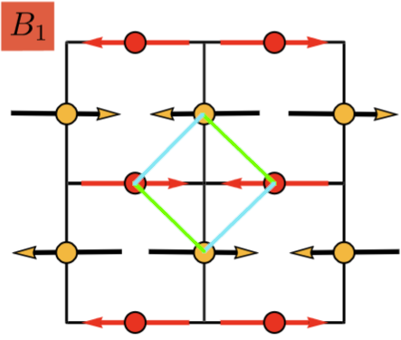

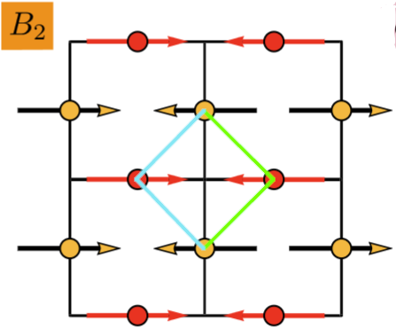

Classical Phase Diagram
Notes:
And now the key phase: C. The spins cant out of the plane — the dot-with-cross symbol means spin pointing into the page on the A sublattice, and the dot-with-arrow means pointing partially out on the B sublattice. The in-plane components still look roughly like A1, so S_EP = −(s_0′, s_0′, s_0′, s_0′) is still uniform — C is not nematic.

Slide 9
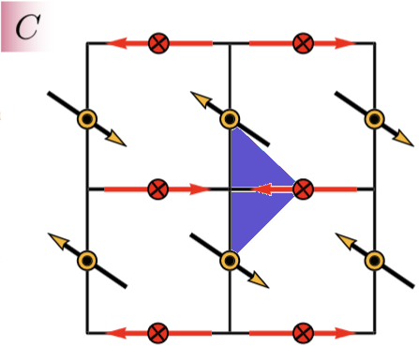
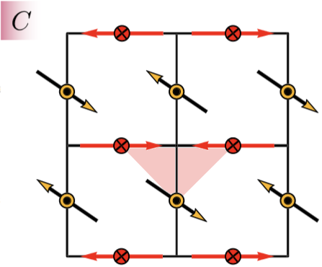
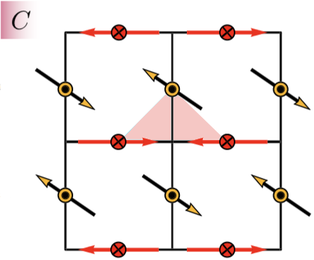
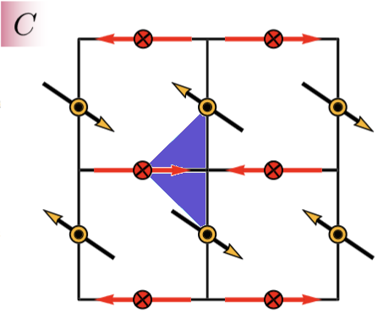


Classical Phase Diagram
Notes:
But this is what is different. The pink triangle: because the spins are now noncoplanar, the scalar chirality S_i · (S_j × S_k) is nonzero. And the pattern around the plaquette is staggered — the triangle on one side of the red bond has positive chirality, the triangle on the other side has negative chirality. The full vector is χEP ∝ (−1, +1, −1, +1). This staggered pattern is preserved by the combined operation T C_4z — the altermagnetic symmetry — but broken by T and C_4z individually. This is why we call it an orbital altermagnet: the altermagnetic symmetry pattern lives in the chirality channel, not in the spin direction. This phase is the one we will quantum-melt. Everything that follows is the story of what survives.

Slide 10
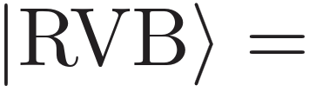
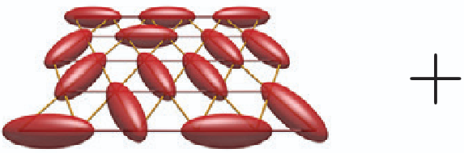
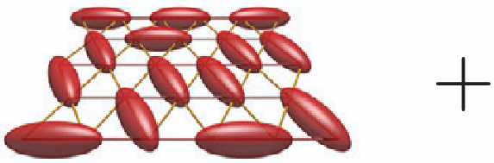
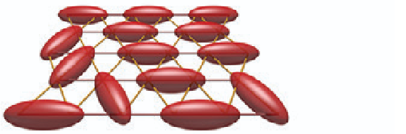
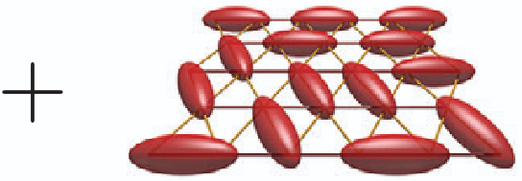

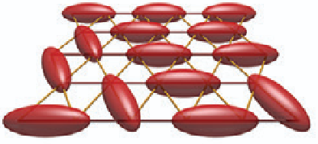
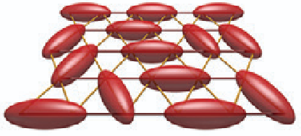

What is a QSL?
No static magnetic order: ⟨Si⟩=0 even at T=0
Ground state is long‑range entangled: cannot be adiabatically deformed to any product state
Supports fractionalized excitations (spin‑½ spinons) and emergent gauge fields
2)
2) Savary and Balents, 2016
Notes:
So what do we mean when we say we quantum-melt a phase into a quantum spin liquid? A QSL is not just a magnet without order. It is something more specific. First: no static magnetic order — ⟨S_i⟩ = 0 even at T = 0. Second: the ground state is long-range entangled — it cannot be adiabatically deformed into any product state. Third, and most importantly: it supports fractionalized excitations — spin-½ spinons that cannot be created by any single local operator — and emergent gauge fields. These are not the magnons from Minseong. Magnons are the Goldstone modes of broken order, also they have Spin-1. Spinons exist precisely because there is no broken spin order.
You can visually think of a superposition of all possible singlet pairings on the lattice, calling it the Resonating Valence Bonds, where yo ucan see that no single bond dominates and that state has no spin order by construction. Also this shows that we cannot write this a product state over any finite region.
Now the question is: how do we actually compute or construct a spin liquid? The answer is we split the spin into two bosons.

Slide 11
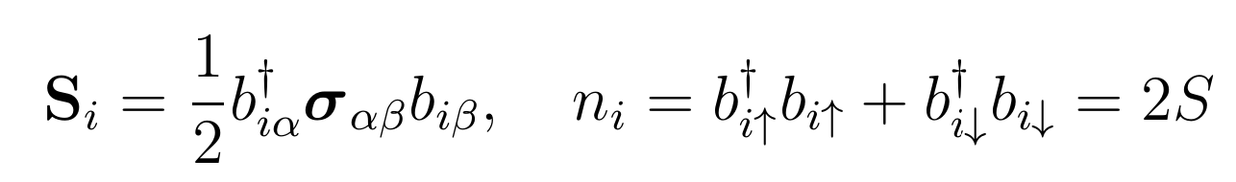


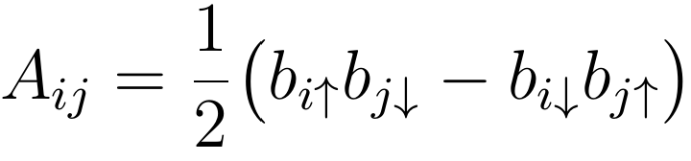
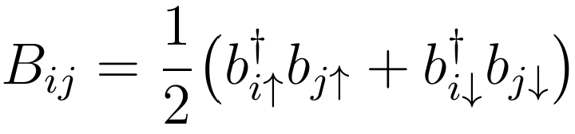
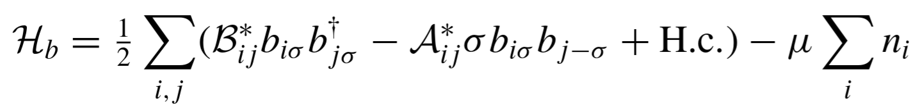
From Schwinger Bosons to Spin Liquids
The Schwinger boson representation and constraint
The gauge redundancy dddd leaves all unchanged
Decouple the Hamiltonian by introducing
leads to free boson Hamiltonian
Notes:
To access these phases mathematically, we use the Schwinger boson representation. Every spin is rewritten as two bosons, subject to a local constraint ni=2Sni​=2S. This decomposition is exact — it just embeds the spin Hilbert space in a larger one. The price is a local gauge redundancy, which the leaves all spin operators unchanged.
We then decouple the quartic exchange interaction using a Hubbard–Stratonovich transformation, introducing two mean-field bond parameters as auxiliary fields. The first is the singlet pairing amplitude Aij
which is the amplitude to create or destroy a spin-0 singlet pair on bond ijij: one boson with spin ↑↑ on site ii and one with spin ↓↓ on site jj, combined antisymmetrically so the total spin is zero. You can think of AijAij​ as the quantum amplitude for sites ii and jj to form a valence bond — it is Anderson's RVB singlet bond made explicit.
The second is the boson hopping amplitude Bij which is the amplitude for a boson to hop from site jj to site ii while preserving its spin — the standard tight-binding hopping of band theory In short: Bijmoves a boson across a bond; Aij creates or destroys a singlet pair on that bond. Together they encode the full resonating valence bond structure of the spin liquid.
The result is a free-boson mean-field Hamiltonian with a lagrange multiplier term mu enforcing the constraint on average. We then Fourier transform to momentum space, where the Hamiltonian takes a quadratic form. A Bogoliubov transformation diagonalizes it, yielding the quasiparticle band structure
The pattern of {Aij,Bij} on the lattice — the Ansatz — is what defines the spin liquid.

Slide 12

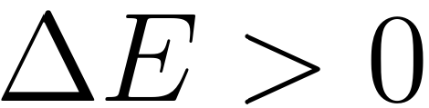
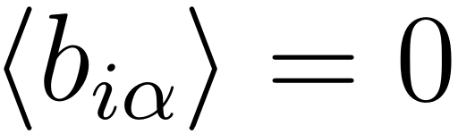

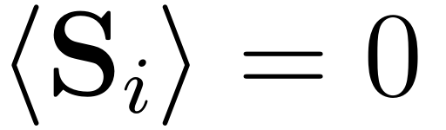
Magnetic Order and Spin Liquids
Bosons condense at k
→ Lowest mode reaches E=0
⇨ Magnetic order
Band stays gapped
→ →
⇨ Spin Liquid
This connects the altermagnet with the concept of QSL!
Notes:
Now the central connection. The μ is a Lagrange multiplier that fixes the average boson density ⟨n_i⟩ = 2S. Tuning μ and the couplings changes the boson dispersion. If the lowest mode reaches E = 0, the bosons condense at some momentum k — and the condensate wavefunction reconstructs exactly the classical spin texture of A1, B1, C, and so on. That is magnetic order.
If the band stays gapped — no condensation — the spins do not order. Instead, the Ansatz {A_ij, B_ij} describes a fractionalized, entangled state: a spin liquid. The same Ansatz that gives magnetic order upon condensation gives a neighboring QSL when kept gapped. This is the bridge between the altermagnet and the concept of a QSL.

Slide 13



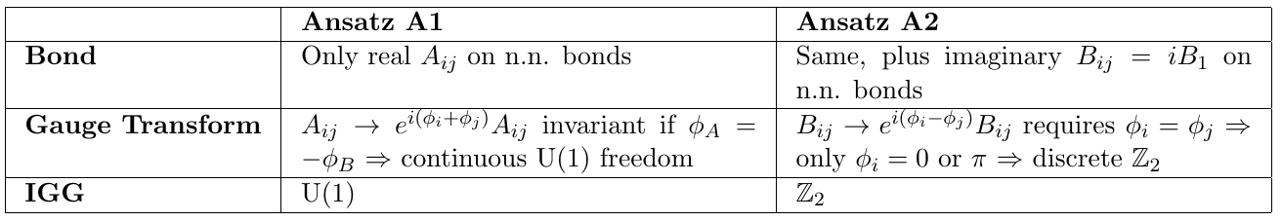
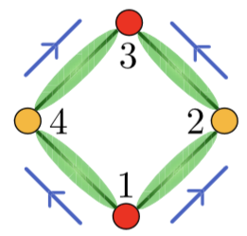
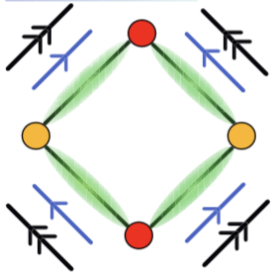
Invariant Gauge Group: U(1) or Z₂?
The mean-field Hamiltonian is invariant under
→The IGG determines the physical nature of the spin liquid's excitations and its stability
Notes:
Not all spin liquids are the same. The type is determined by the Invariant Gauge Group, the IGG. The Schwinger boson construction always has a local U(1) gauge redundancy. But a specific Ansatz {A_ij, B_ij} will typically break most of that redundancy. The IGG is the subgroup of gauge transformations that leaves the Ansatz invariant. If a continuous U(1) subgroup survives, you have a U(1) spin liquid — but this is generically unstable in 2D. If only the discrete sign flip b_i → −b_i survives, you have a Z₂ spin liquid — a stable topological phase in 2D. In practice: adding imaginary B_ij to an Ansatz almost always reduces the IGG from U(1) to Z₂, because imaginary bonds are sensitive to phase transformations that real bonds are not. Phase A1 has only real A_ij → IGG = U(1)

Slide 14
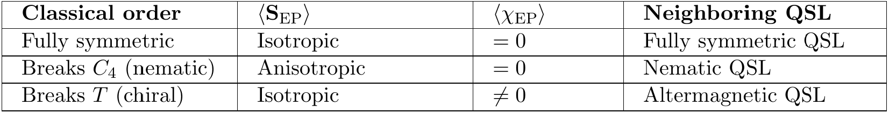
Matching phases to SB Ansätze
The strategy:
Choose a pattern of Aij,Bij on NN and NNN bonds (the Ansatz).
Diagonalize the boson Hamiltonian, find the lowest mode.
Tune μ so this mode condenses.
Reconstruct the spin texture from the condensate; check if it matches A1, B1, C, etc.
NN/NNN are enough- no unit cell enlargement needed
Find the minimal Ansatz whose condensation recovers that phase → its gapped version is the neighboring QSL, inheriting the IGG!
Notes:
So how do we actually find the neighboring spin liquid for each classical phase? The strategy is to reverse-engineer the Ansatz. Step one: choose a pattern of A_ij and B_ij on nearest-neighbor and next-nearest-neighbor bonds. Step two: diagonalize the free-boson Hamiltonian via a Bogoliubov transformation. Step three: tune μ until the lowest mode condenses. Step four: reconstruct the spin texture from the condensate and check whether it matches the target phase — A1, B1, C, and so on. Nearest and next-nearest-neighbor bonds are sufficient for all six phases — no unit cell enlargement needed. The gapped version of that same Ansatz — where the bosons do not condense — is the neighboring QSL, and it inherits the same IGG and discrete symmetry as the parent ordered phase. This is the symmetry inheritance that makes the orbital altermagnet so special.

Slide 15
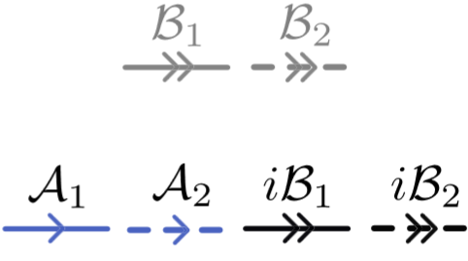

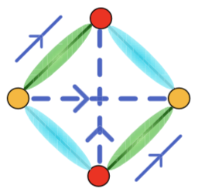
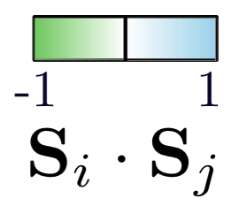

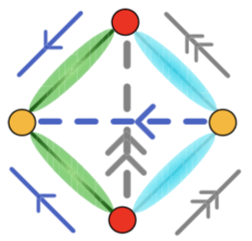

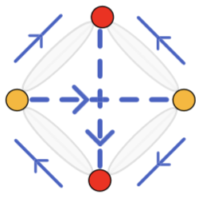
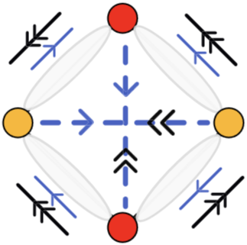
Phase Diagram Overview
Notes:
Here is the full picture. Each panel in Figure 2 shows the Schwinger boson Ansatz for one classical phase. Blue arrows are real A_ij — singlet pairing. Black and gray arrows are real and imaginary B_ij — boson hopping. The colored ellipses show ⟨S_EP⟩ directly in the spin-liquid regime, before any condensation — confirming that the symmetry of the QSL matches the symmetry of the classical phase. Every classical phase has a neighboring spin liquid. But phase C is distinguished: it is the only Ansatz that requires imaginary B_ij and shows a chirality pattern in the spin-liquid regime. That is the one we care about.

Slide 16



Phase Diagram Overview
Notes:
Here is the full picture. Each panel in Figure 2 shows the Schwinger boson Ansatz for one classical phase. Blue arrows are real A_ij — singlet pairing. Black and gray arrows are real and imaginary B_ij — boson hopping. The colored ellipses show ⟨S_EP⟩ directly in the spin-liquid regime, before any condensation — confirming that the symmetry of the QSL matches the symmetry of the classical phase. Every classical phase has a neighboring spin liquid. But phase C is distinguished: it is the only Ansatz that requires imaginary B_ij and shows a chirality pattern in the spin-liquid regime. That is the one we care about.

Slide 17
The Altermagnetic Spin Liquid
orbital AM → noncoplanar order with staggered scalar chirality, zero net magnetization
IGG = Z₂ (Z₂ spin liquid)
Spin-rotation restored: ⟨Si⟩ = 0, but time-reversal still broken by the surviving altermagnetic chirality pattern
Therefore: Z₂ topological order + AM scalar chirality → altermagnetic spin liquid
Notes:
This is the main result. The orbital altermagnet — phase C — has a neighboring Ansatz with IGG = Z₂, giving a Z₂ spin liquid. Now look at what happens in the spin-liquid regime, where the bosons are gapped and there is no condensation. Table II tells us: ⟨S_EP⟩ is isotropic, (1, 1, 1, 1) — C_4z is fully restored in the spin sector. But ⟨χEP⟩ is staggered, (−1, +1, −1, +1) — time-reversal is still broken in the chirality sector, with exactly the T·C_4z pattern of an altermagnet. Let me say that again clearly: ⟨S_i⟩ = 0 everywhere — there is no spin order. But the altermagnetic chirality pattern survives in the fractionalized phase. The result is Z₂ topological order combined with a persistent altermagnetic scalar chirality — this is the altermagnetic spin liquid: a symmetry-enriched topological phase that did not exist before this paper.

Slide 18
Summary
The checkerboard J1​-J2​-K model hosts, besides collinear and nematic phases, a noncoplanar orbital altermagnet with a staggered scalar chirality pattern invariant under TC4z.
Using Schwinger bosons, each classical phase has a neighboring spin liquid; their SR‑invariant symmetry patterns are inherited via SEP​ and χEP​.
The orbital altermagnet’s neighbor is an altermagnetic Z₂ spin liquid: no spin order, but a persistent altermagnetic chirality pattern
Notes:
Let me close with three take-home points. First: the checkerboard J₁–J₂–K model hosts, alongside collinear and nematic phases, a noncoplanar orbital altermagnet — phase C — with a staggered scalar chirality pattern invariant under T·C_4z. Second: using Schwinger bosons, each classical phase has a neighboring spin liquid that inherits the same discrete symmetry via S_EP and χ_EP. Third: the orbital AM's neighbor is an altermagnetic Z₂ spin liquid — no spin order, but a persistent altermagnetic chirality pattern and Z₂ topological order. The paper lays the foundation to altermagnetic QSLs.
((The most direct experimental route would be STM or local susceptibility measurements sensitive to bond chirality — and the open question is whether candidate frustrated altermagnetic materials such as Mn₅Si₃ or CsCr₃Sb₅ can host this phase. Frustrated altermagnets are largely unexplored. This paper opens the map.))

Slide 19
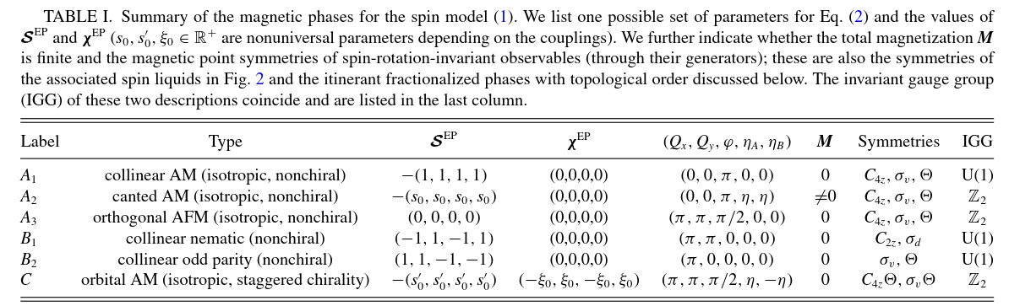
Summary of the classical magnetic phases

Slide 20
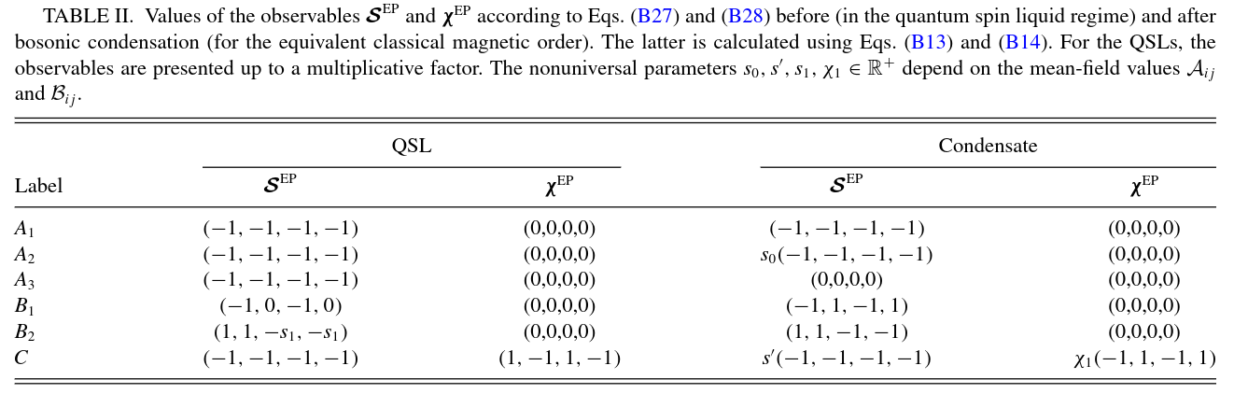
Neighbors and their SR observables

Slide 21
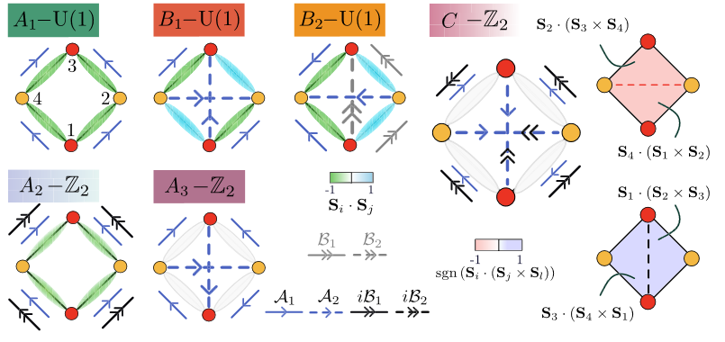
The Ansätze and Their Correlators
Each panel: Schwinger‑boson Ansatz {Aij,Bij} for one classical phase (A1, A2, A3, B1, B2, C)
Blue arrows = real Aij(singlet pairing); black/gray arrows = real/imaginary (boson hopping)
Colored ellipses show ⟨SEP⟩ in the spin‑liquid regime; same symmetry pattern as the corresponding classical phase
Notes:
Now that we’ve seen how Schwinger bosons work and how condensation gives the classical orders, the figure on the left is really the heart of the ‘nearby spin liquids’ story.
Each panel in this figure is one Schwinger‑boson Ansatz {Aij,Bij} corresponding to one of the classical phases A1, A2, A3, B1, B2, and C. The arrows on the bonds encode the mean‑field parameters:
Blue arrows denote real Aij​, the singlet pairing amplitude between sites ii and jj.
Black and gray arrows denote real or imaginary BijBij​, the boson hopping amplitudes. The presence of imaginary hoppings and second‑neighbor bonds is what reduces the gauge group from U(1) down to Z₂ in some cases.
Superimposed on each Ansatz you see colored ellipses sitting on plaquettes. These represent the nearest‑neighbor spin products ⟨SEP⟩⟨SEP⟩ evaluated directly in the spin‑liquid regime, i.e. before any bosons are condensed. The key idea is: you can already read off the spatial symmetry of the QSL from these correlators:
In A1, A2, and A3, the ellipses are all equivalent: ⟨SEP⟩⟨SEP⟩ is isotropic and non‑nematic, matching the fully symmetric collinear and orthogonal phases in the classical diagram.
In B1 and B2, the ellipses clearly break C4C4​ rotation down to a twofold symmetry — these are the nematic spin liquids sitting above the nematic orders B1 and B2.
So the first message of this figure is: each spin liquid faithfully inherits the lattice symmetries of its parent classical phase, which you can see visually just from ⟨SEP⟩⟨SEP⟩.
The second, more special message concerns phase C, the orbital altermagnet. In its panel, in addition to isotropic ⟨SEP⟩⟨SEP⟩, they also show a staggered scalar‑chirality pattern ⟨χEP⟩⟨χEP​⟩ in the spin‑liquid state. This tells you that:
Time‑reversal is broken in spin‑rotation–invariant observables.
The altermagnetic pattern of scalar chirality survives even when spin‑rotation symmetry is restored and the bosons are not condensed.
So phase C’s spin liquid is genuinely an altermagnetic spin liquid: it has Z₂ gauge structure (IGG = Z₂) and a staggered chirality pattern inherited from the orbital AM.
To summarize what’s on the right of this slide: the reduced Table I lists, for each label, the IGG (U(1) or Z₂) and the symmetries of the spin liquid. A1, B1, and B2 give U(1) spin liquids; A2, A3, and C give Z₂ spin liquids. Putting Fig. 2 together with this table, you see precisely how the spin‑liquid Ansätze encode both symmetry and gauge structure, and how the orbital AM C leads to a Z₂ altermagnetic spin liquid with staggered chirality.
→ "Let me now focus on phase C, because it is the only Ansatz with a nonzero chirality pattern in the spin-liquid regime. This is the main result.

Slide 22

Classical Spin Ansatz
Q: ordering wavevector
φ: phase shift between sublattices
ηA/B​: out-of-plane canting
Grid search over (J2,K) minimize the classical energy of these params through gradient-descent algorithm
Notes:
How are these phases actually found? Every spin texture is parameterized as a general spiral: ordering wavevector Q sets the period and direction, φ is the phase shift between the two sublattices, and η_{A/B} is the out-of-plane canting — zero for all coplanar phases, nonzero only for phase C. For each coupling point (J₂, K), a grid search followed by gradient descent finds the global energy minimum. Phase A1 is the anchor: Q = (0,0) (describe Q), φ = π, η = 0 → antiparallel spins, collinear AM. Its SR-invariant observables: S_EP all equal — no nematicity — and χEP = 0 — no chirality. All magnetic point-group symmetries preserved modulo spin rotation.
→ "A1 is the base case: fully symmetric AM. As frustration increases, two nematic phases appear — B1 and B2. They break C₄z in spin-rotation-invariant observables, but crucially, their chirality χ_EP stays zero."

Slide 23


Phase C: The Orbital Altermagnet
The key pattern: χEP∝(−1,1,−1,1)
Symmetry point:
χEP​ is odd under T and under C4z separately.
The pattern (−1,1,−1,1) is invariant under TC4z​ →defining symmetry of an altermagnet
‘orbital’ because, in an electron system, scalar spin chirality on a plaquette induces circulating orbital currents with the same staggered T⋅C4z pattern
Notes:
Phase C is the new phase this paper introduces. When frustration is strong enough, it becomes energetically favorable to cant the spins out of the plane: ηA > 0, ηB < 0, with ηA + ηB = 0. This generates nonzero scalar spin chirality on every triangle. The pattern is staggered: χ_EP ∝ (−1, 1, −1, 1). Now the symmetry argument. χ_EP is odd under T alone — flipping time reversal reverses all chiralities. χ_EP is also odd under C₄z alone — rotating 90° maps (−1,1,−1,1) to (1,−1,1,−1). But the combined T·C₄z maps it back to itself: invariant under TC₄z That is precisely the defining symmetry of an altermagnet — but now in the chirality channel. The phase transition from A1 to C is second order: χ_EP turns on continuously, as shown in right left plot. Why "orbital"? In an electron system, scalar chirality on a plaquette corresponds to circulating orbital currents. These currents are locally nonzero but vanish globally — not through translation symmetry, but through C₄z·T.
→ "We now have the classical phases and we know which one has the AM symmetry in its chirality. The next step is to connect each classical phase to a Schwinger-boson Ansatz — and then ask what lives on the QSL side of that connection."

Slide 24

Experimental Outlook

